Slide 1
FEATURE ANALYSIS AND PRICE PREDICTION FOR HANDSETS
A comprehensive overview of features and pricing

Slide 2
INTRODUCTION
Objective: To analyze and visualize the top mobile handsets based on features such as price , RAM, camera specifications etc.
Data Source: Processed Flip data CSV file.
Dataset Details:-Information on specifications (memory, RAM, battery, etc.) and price.

Slide 3
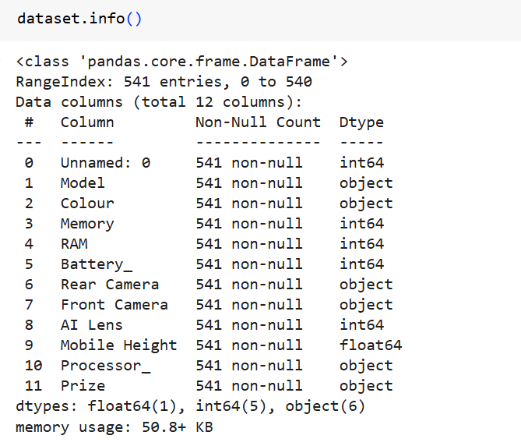
Data Overview
Dataset Structure:
Total Entries: 541 rows × 12 columns
Predictive price estimation model.

Slide 4
TECHNOLOGY STACK:
Python: Pandas, NumPy, Scikit-learn,
Visualization: Matplotlib, Seaborn.
Reporting: Jupyter Notebook, PowerPoint.
Chart: Line plot ,Pie chart.

Slide 5
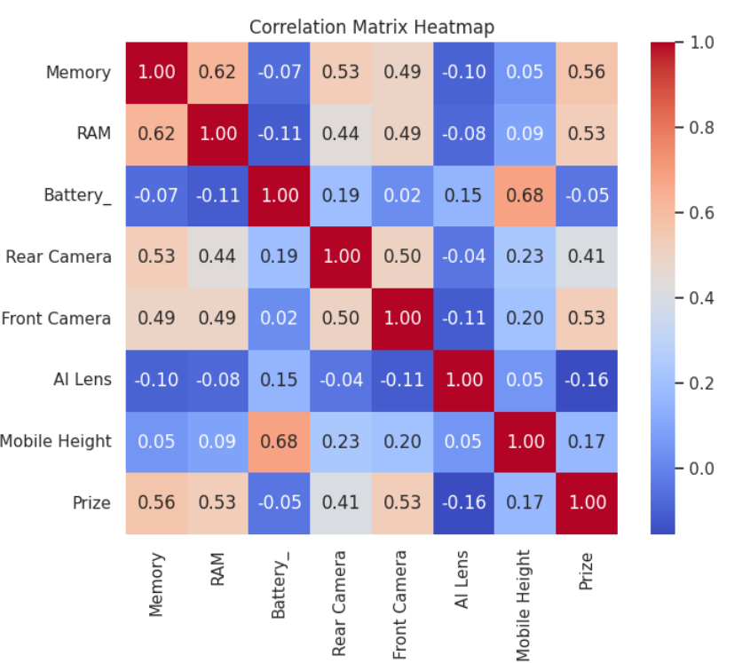
INSIGHTS AND TRENDS
Insights: Correlation between RAM and price.
Memory and Price (0.57):Positive correlation: Higher memory typically contributes to a higher price.
RAM and Price (0.53):Positive correlation: More RAM generally leads to a higher price.
Battery and Price (-0.03):Almost no correlation: Battery capacity doesn't significantly affect the price
Average price range for different specifications.
Front Camera and Price (0.53):Positive correlation: Better front cameras are often associated with more expensive devices.
Rear Camera and Price (0.41):Moderate positive correlation: Rear camera quality also plays a role in pricing but is less influential than front cameras.

Slide 6
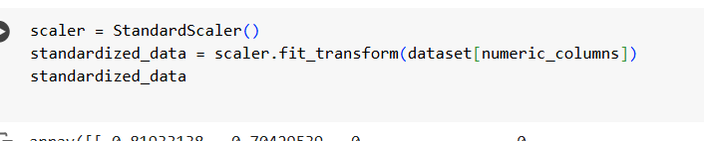
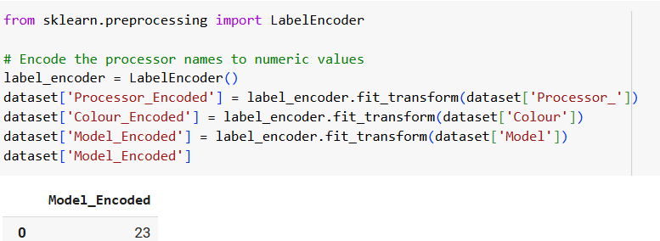
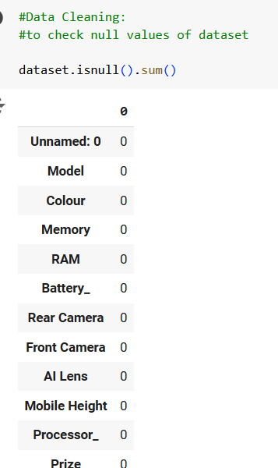

PROJECT TASKS AND APPROACH
Data Exploration
Inspect for missing values, outliers, inconsistencies.
Analyse feature distributions and correlations with price.
Data Preprocessing
Encode categorical variables.
Normalize numerical features.
Feature Analysis and Extraction
Techniques: RFE, Lasso Regression.

Slide 7
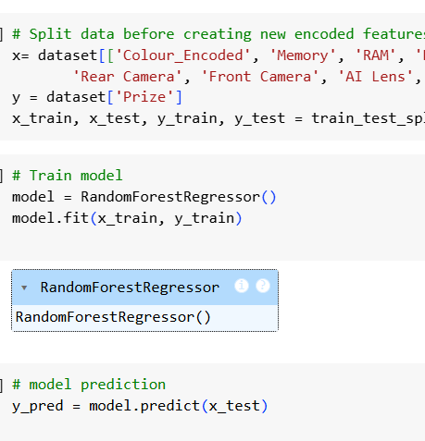
MODEL BUILDING
Split dataset: 80-20 (Training-Testing).
input Features (x): Selected columns from the dataset including features like 'Colour Encoded', 'Memory', 'RAM', 'Battery_', 'Rear Camera', 'Front Camera', 'AI Lens', 'Mobile Height', 'Processor Encoded', and 'Model Encoded.
Target Variable (y): The 'Prize
A Random Forest Regressor model is created using the RandomForestRegressor() class.
Predictions are stored in the variable y pred.

Slide 8
MODEL EVALUATION
Metrics Used:
Mean Absolute Error (MAE).
Root Mean Squared Error (RMSE).
R² Score.
Comparison of Algorithms:
Highlight best-performing model and results.
MAE: 1620.3277122830443
R²: 0.8660694902888366
MSE: 7411632.883681148

Slide 9
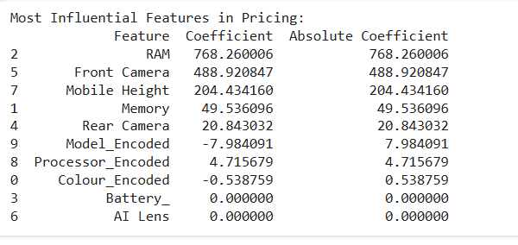
COEFFICIENT AND ABSOLUTE COEFFICIENT
Focus on improving RAM and Front Camera specifications to justify higher pricing..
Deprioritize efforts on features like Battery_ or AI Lens, as they have no measurable impact on the price in this model.

Slide 10
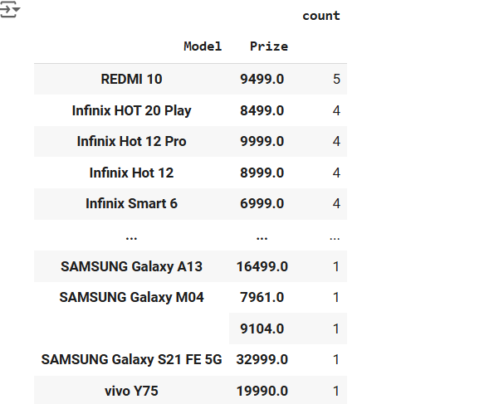
KEY FINDINGS
Relationship between model count and price.
Predictive as out of them REDME 10 has highest selling of records.

Slide 11
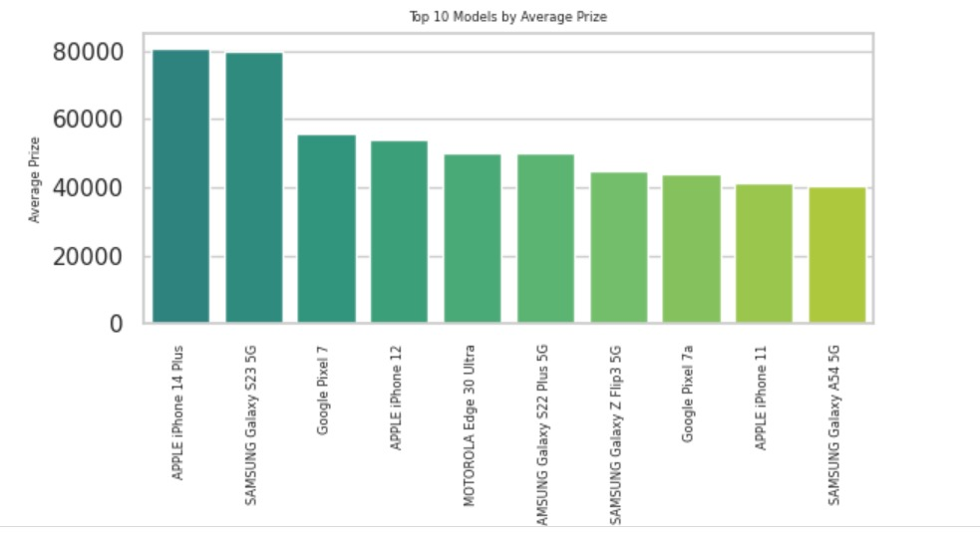
TOP 10 MODEL BY AVERAGE PRICE
Apple and Samsung dominate the list, with multiple models appearing in the top 10, indicating their stronghold in the premium price segment.
Consumers looking for the best value might focus on mid-tier models like the Pixel 7a or Galaxy A54, which provide affordability within the top-performing range.

Slide 12
RECOMMENDATIONS
Feature Optimization:
From earlier insights, focus on enhancing RAM, camera quality, and mobile dimensions since they have the most significant influence on pricing.
Value Seekers:
Look at models like the Google Pixel 7a or Samsung Galaxy A54 5G for strong performance at a lower price point.
Targeted Advertising:
Promote mid-range models like the Pixel 7a and Galaxy A54 5G as affordable options with flagship-like performance for value-conscious consumers.

Slide 13
Thank you.
Upasna Agrawal

